Slide 1
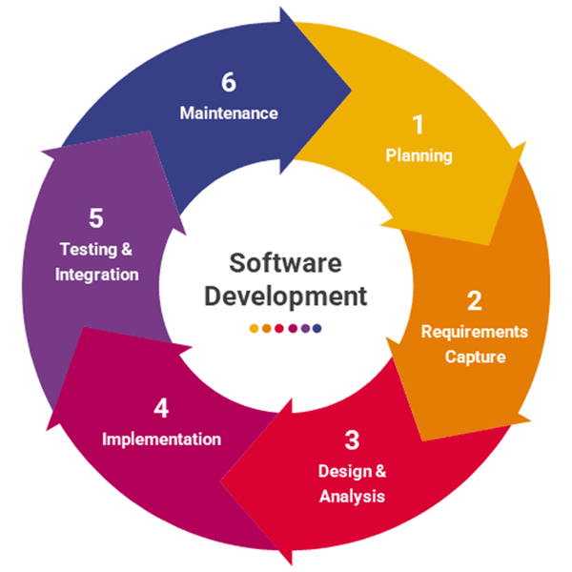
GLOSSARY
Reto 2 _
March 7th_ Paula Tabares
PART 1

Slide 2
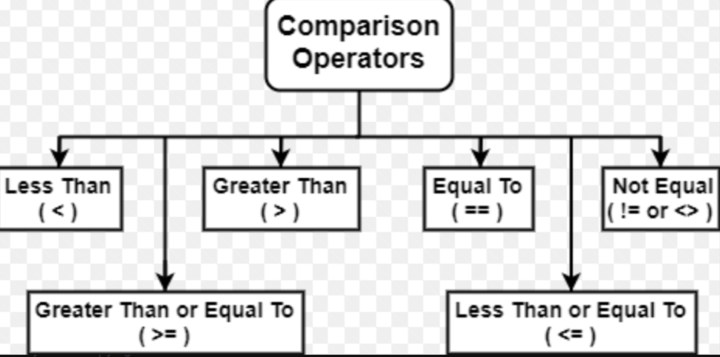

Equations
Translate into spanish
PRONUNCIATION PRACTICE
…
…
if
true
false
so

Slide 3
equations
PRONUNCIATION PRACTICE:
Variables AND numerical value in an equation.
python
Your turn
g= j < t
U = 3 < f
x == 10 > s
If (e < 13):
p = y > t != j
q != k > v = h
Pronunciation Practice

Slide 4
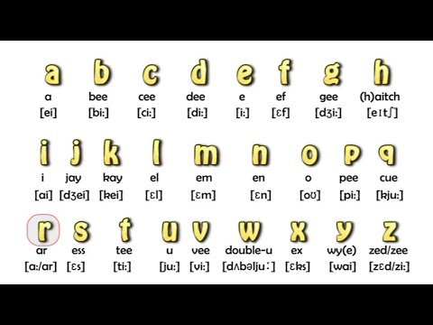
THE TIME
Your Audio

Slide 5
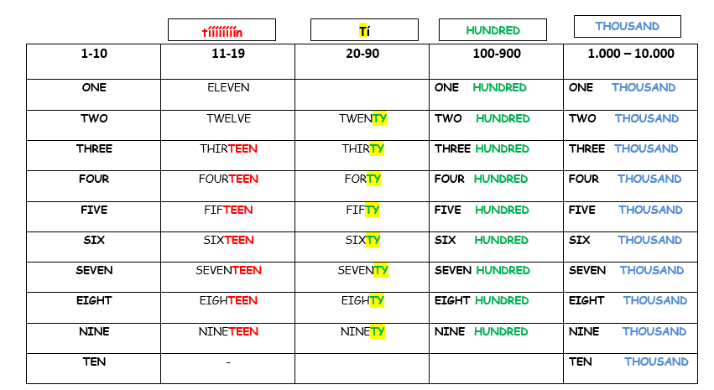
Your turn -NAMES -GRABE AQUÍ!
AUDIOS
A

